Slide 1
Transportation Options in Pinellas County
Presented by Ross Silvers, Mobility Manager at PSTA
August 2, 2017

Slide 2

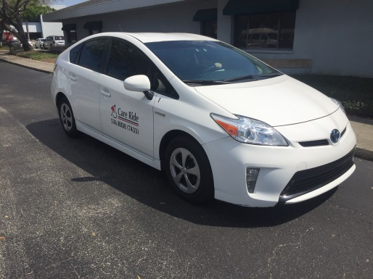
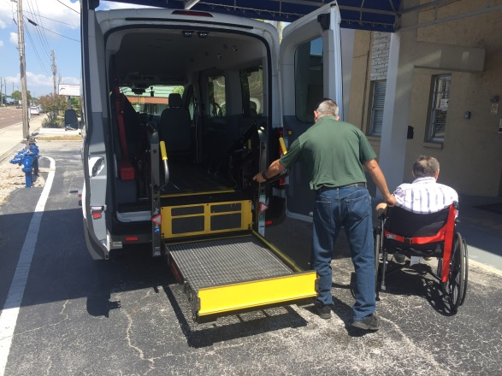
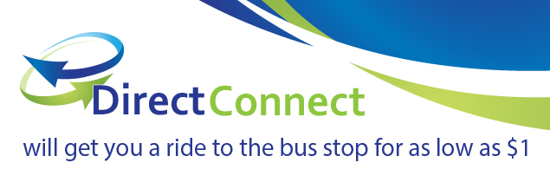
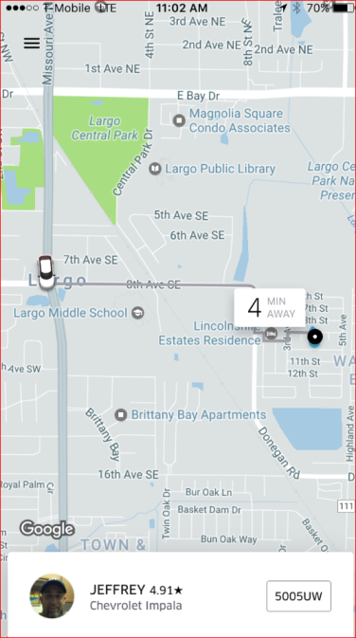

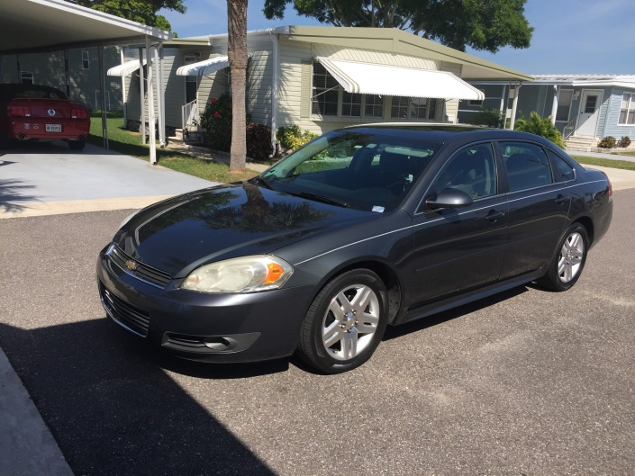
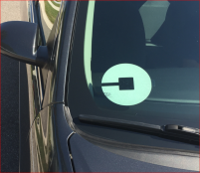
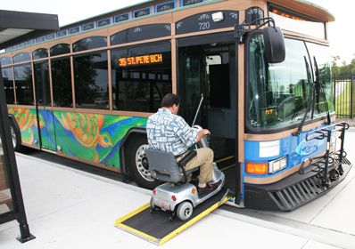
Transportation Service Options
Bus, Trolleys, Connector
DART (ADA Paratransit)
Transportation Disadvantaged Services
On-Demand Services

Slide 3

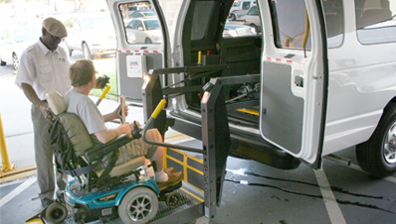
ADA Paratransit Service: Door-to-Door Service for Individuals with Disabilities
Eligibility: Disability prevents independent use of regular, accessible bus, or cannot travel independently to or from a bus stop. Required to parallel existing public transit.

Slide 4
Transportation Disadvantaged (TD)
The Florida TD Commission (CTD) designated PSTA to apply for TD funds from the state under guidance from the Local Coordinating Board (LCB), a voluntary board which is staffed by and reporting to Forward Pinellas.
Eligibility is based upon a Pinellas County address, household income below 150% of poverty, and no other transportation for life-sustaining trips.
Eligibility provides for one subsidized bus pass per month for one calendar year: monthly pass for $11 ($70 retail) or 10 non-consecutive days for $5 ($45 retail value); PCDHS pays $5 of this cost for Health clients in need.

Slide 5

Transportation Disadvantaged (TD)
On-Demand Services
Late Shift: 25 FREE RIDES/Mo. from 10PM- 6AM
One $3 Urgent Day Ride/Month
  Must get TD pass every month
  Choose Uber, United Taxi, or Care Ride (wheelchair)
    $20 cap on United Taxi trips, passenger pays any additional

Slide 6

Take Uber, United Taxi or Wheelchair Transport to Direct Connect bus stops and ride a PSTA bus for free to your final destination.
Trips must begin or end at the designated stop, within the same zone.
PSTA pays the first $5, most trips under 3 miles with Uber cost the rider under $2.
Service available 6AM to 11PM, seven day.

Slide 7
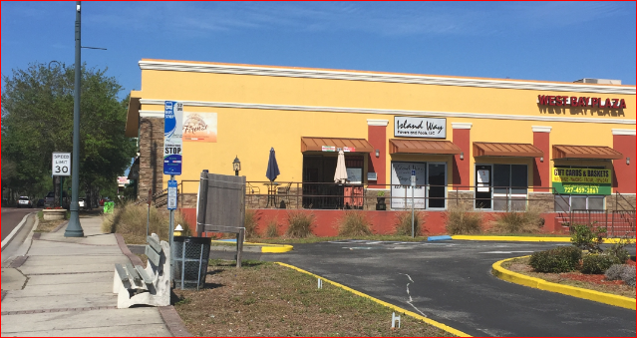
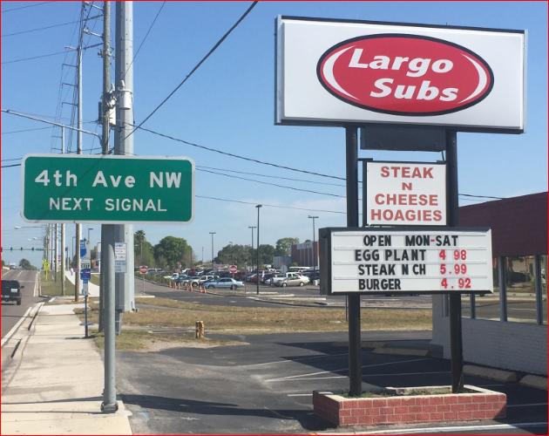
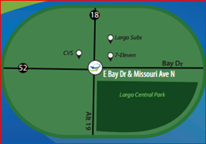
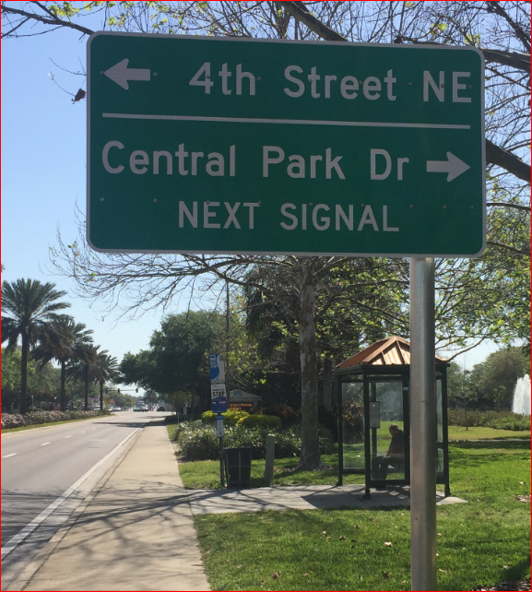
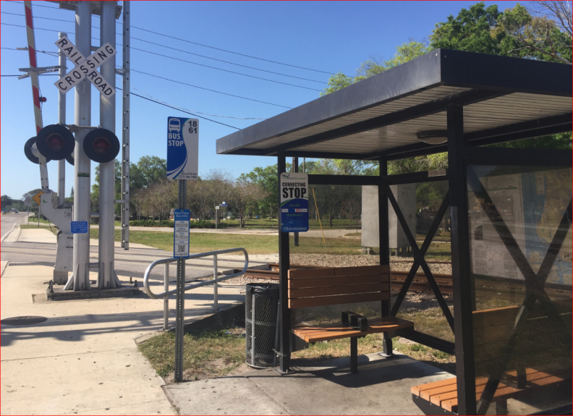
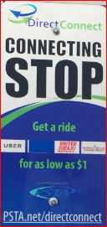

Slide 8
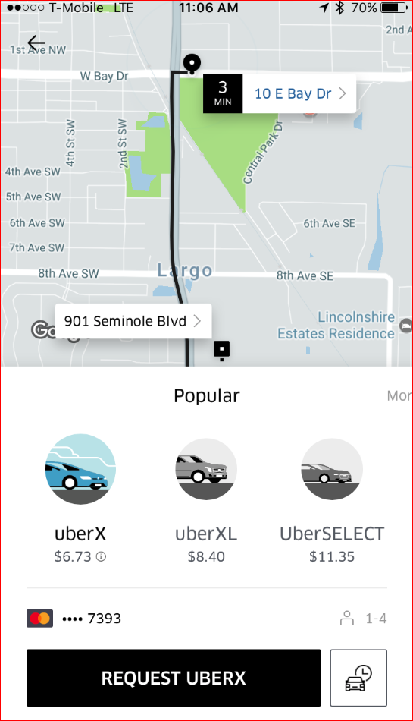
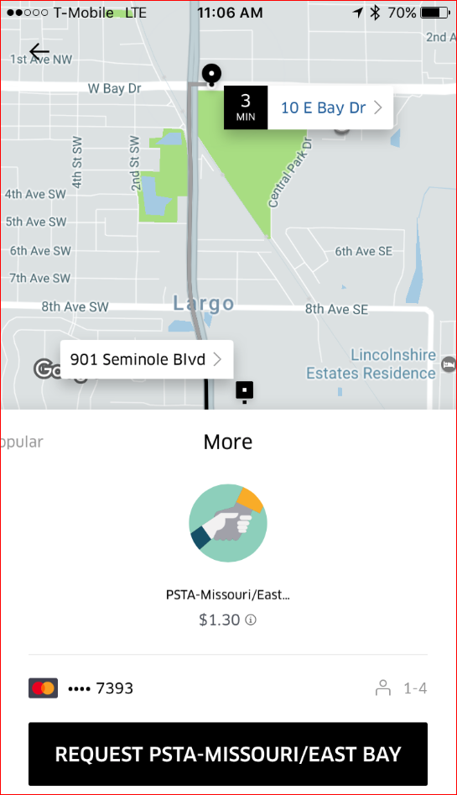
Select the PSTA payment option then click Request PSTA

Slide 9
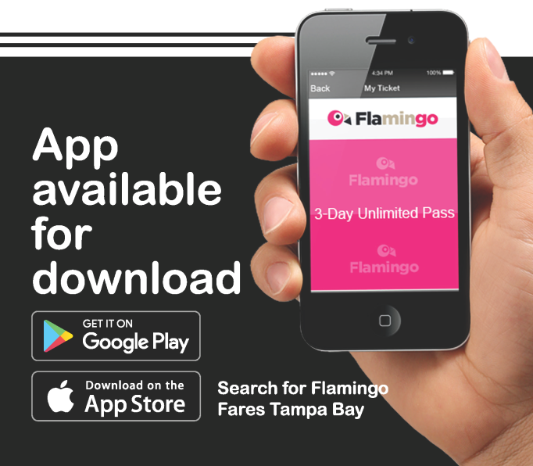
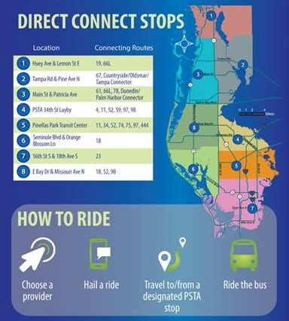

Coming Soon…
2018: Regional Fare System will be shared by five counties allowing a passenger to use a smartcard or app to buy one fare used region-wide.
Late 2017: Improvements to Direct Connect for greater flexibility and mobility (subject to Board approval).
2018: On-Demand, same-day DART trips for same cost as regular advanced reservation DART trips.

Slide 10
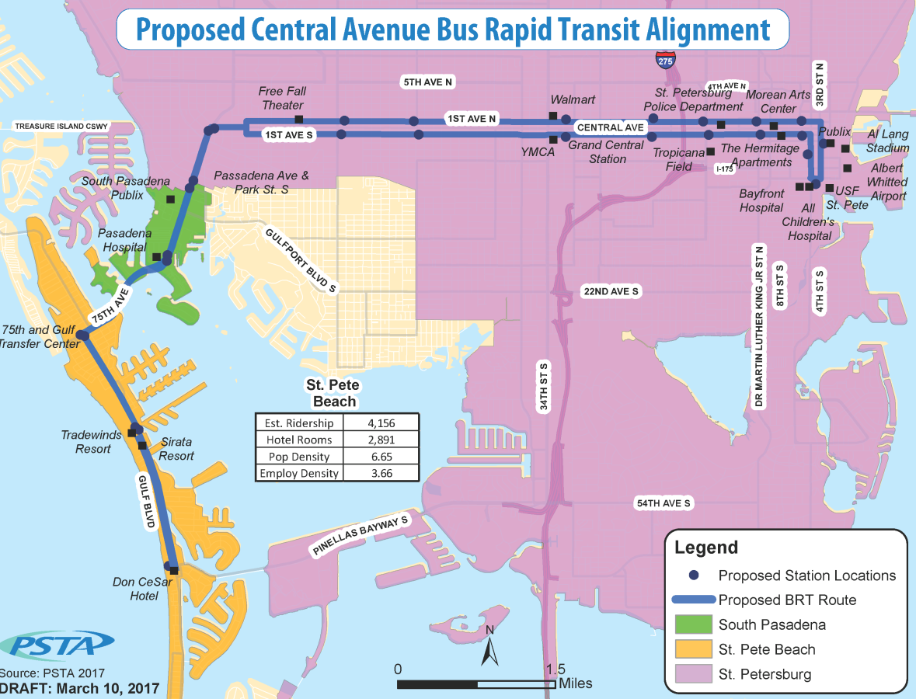
Central Avenue BRT:

Slide 11
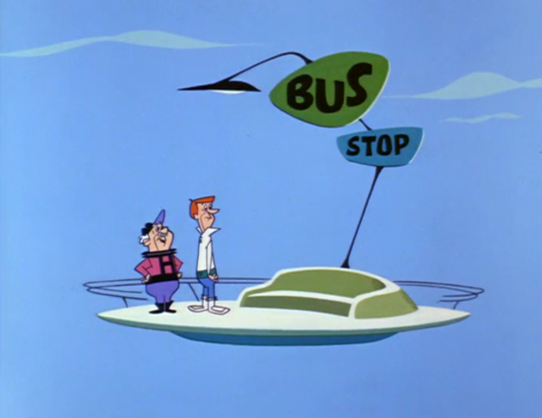
Questions? Ask Ross rsilvers@psta.net
10

